Slide 1
Software Engineering
BlueBee Project
Group 2 – K57CA

Slide 2
Members
Nguyễn Thế Huy – Project Leader
Lê Văn Khoa
Nguyễn Văn Khánh
Nguyễn Duy Kiên
Vũ Ngọc Sơn

Slide 3
Outline
Main Idea
“Big change”
Github
Pivotal Tracker
Teamcrop
UML
Lint
Demo
Q&A

Slide 4
Main Idea: A website
Where we can organize document, test of UET, like tailieu.vn, scribd.com
Student can search document, test by teachers, subject, download and upload
Student can discuss many topics about test, learning,… like facebook
Where student can get many information about courses, teachers and send feedback to their teachers

Slide 5
“Big change”
We want every university can use our product
A mini social network for education
Improve student's experience in learning, sharing
Connect the student generation
Download document, test in one website. Student can use dropbox or google drive without leaving their browser

Slide 6
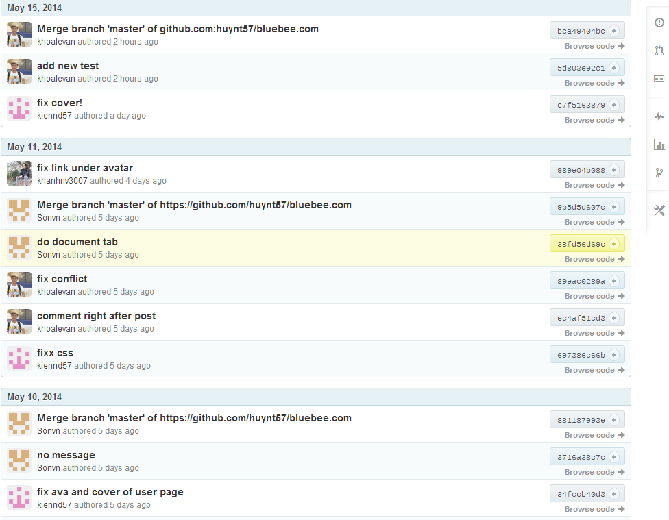
Github

Slide 7
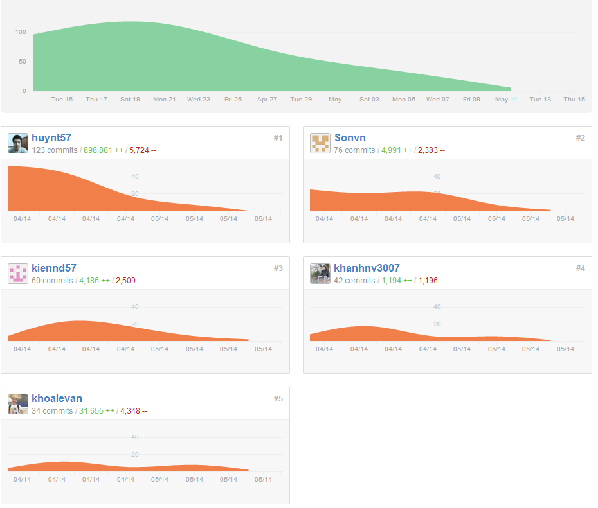
Github
Notes:
7

Slide 8
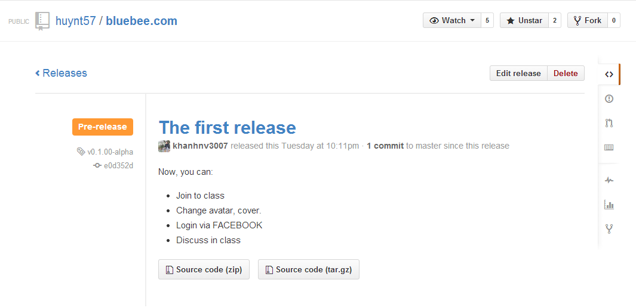
Release

Slide 9
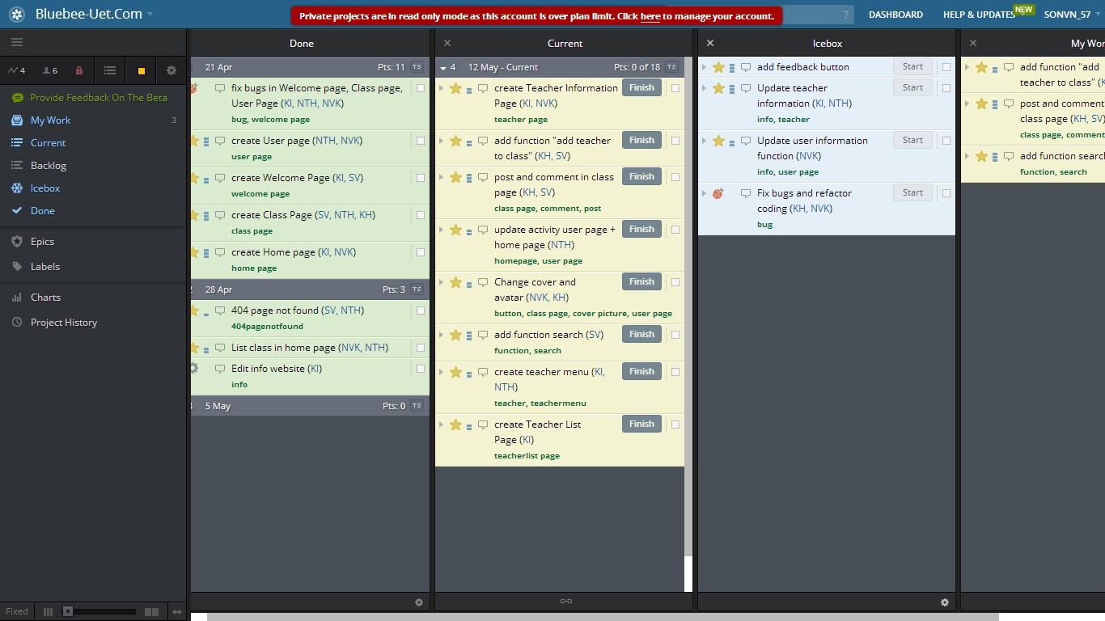
Pivotal tracker

Slide 10
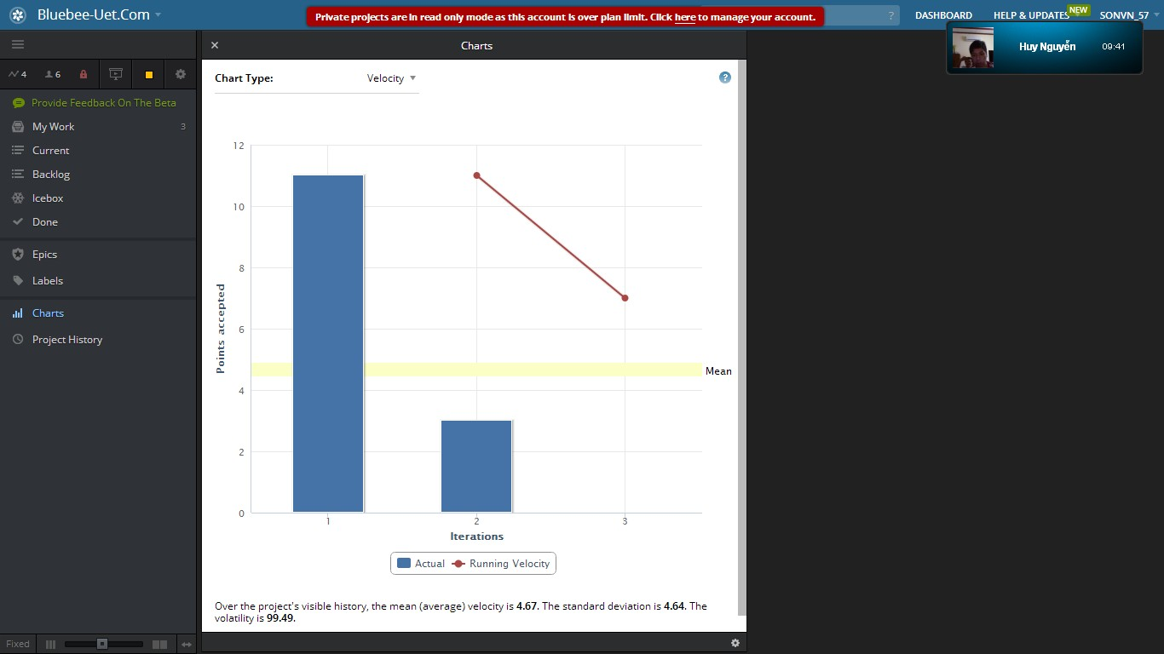
Pivotal tracker

Slide 11
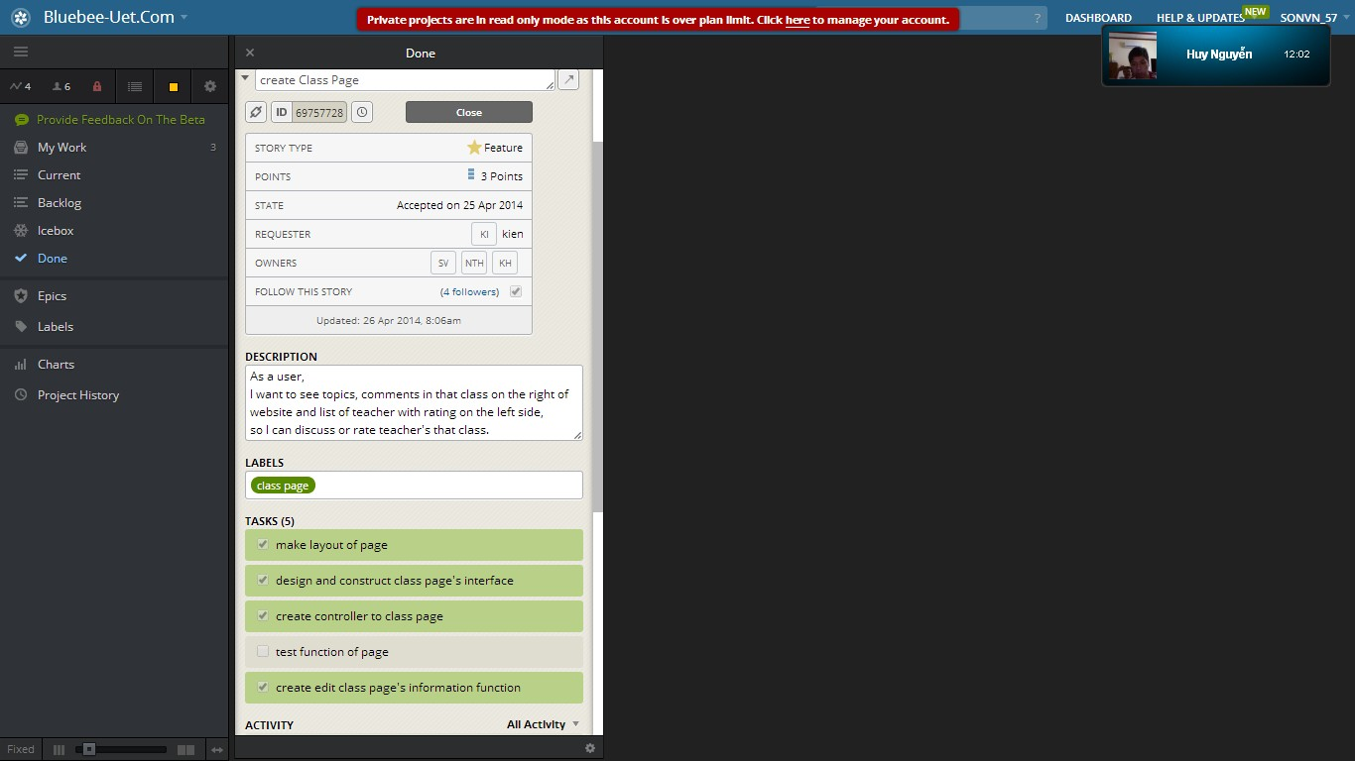
Pivotal tracker

Slide 12
Teamcrop
Why ? Because our accounts in pivotal tracker are out of date :))
Teamcrop is now free for ALL PLAN
Teamcrop is a startup of Vietnamese, and it's using a PHP framework comes from Viet Nam
It has many functions that can impress user

Slide 13
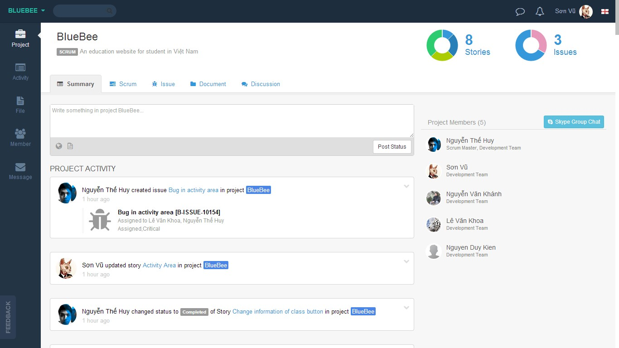
Teamcrop

Slide 14
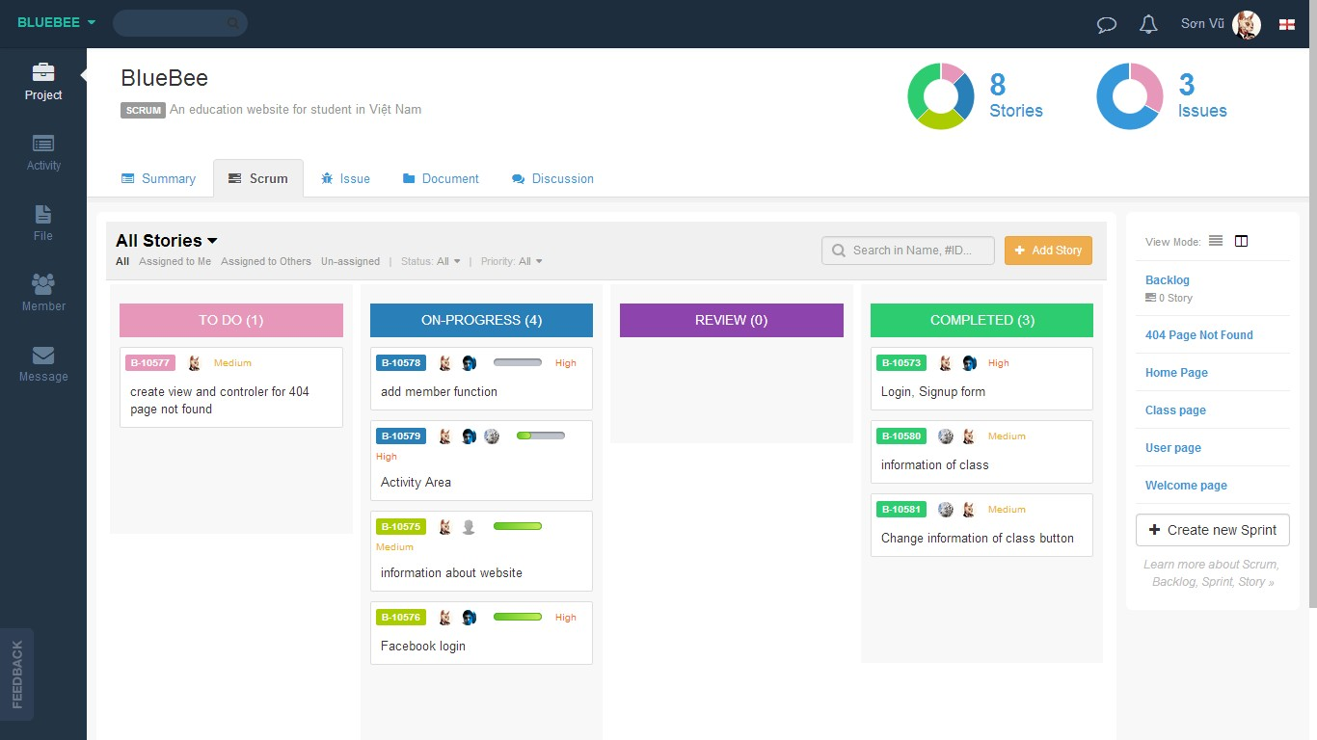
Teamcrop

Slide 15
Teamcrop

Slide 16
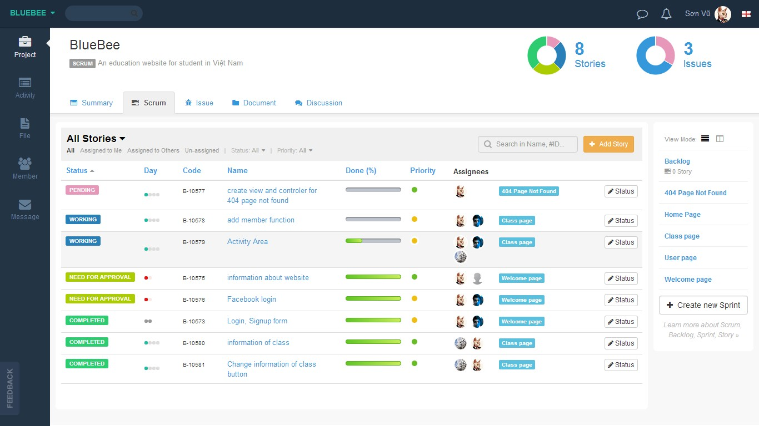
Teamcrop

Slide 17
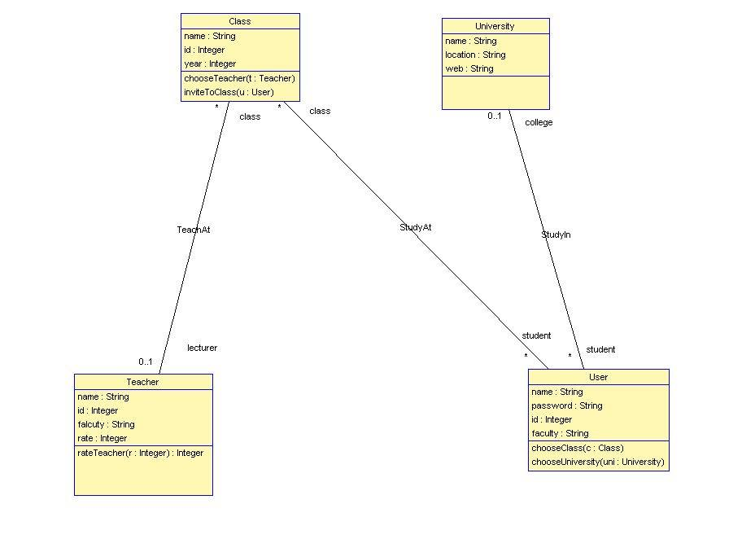
UML

Slide 18
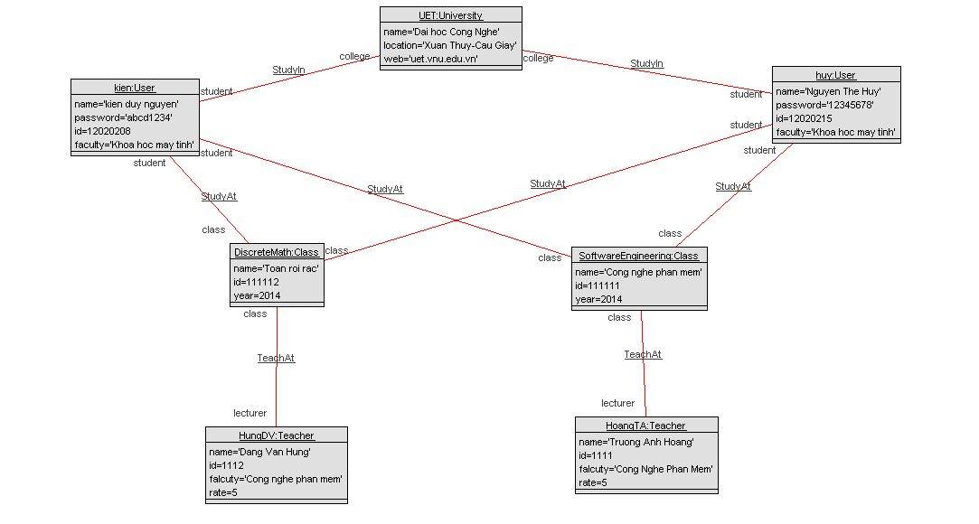
UML

Slide 19
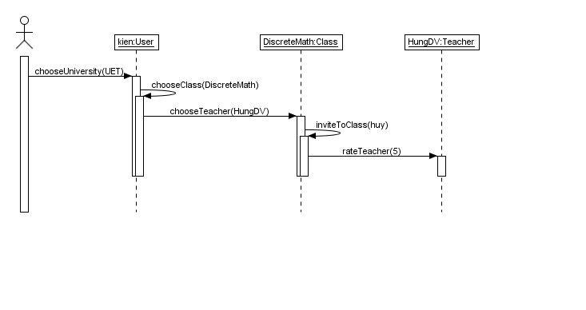
UML

Slide 20
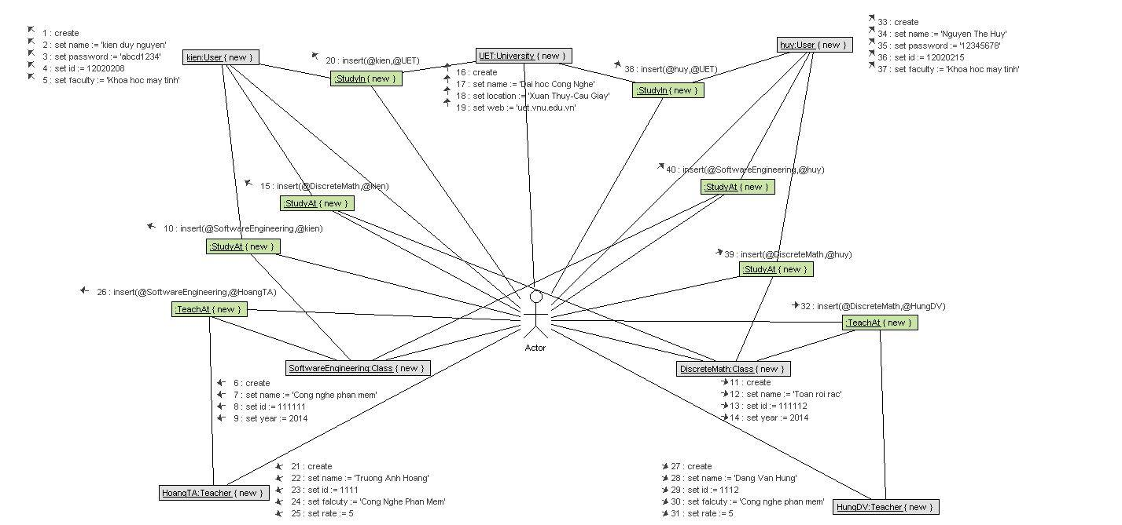
UML

Slide 21
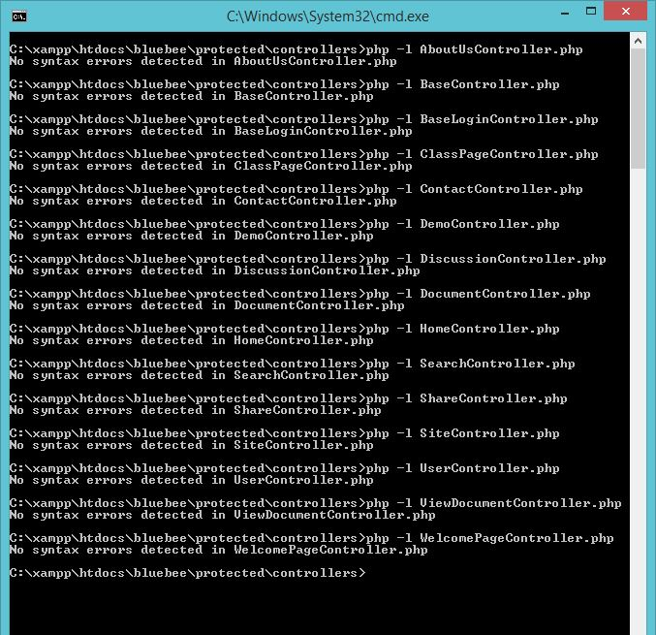
Lint

Slide 22
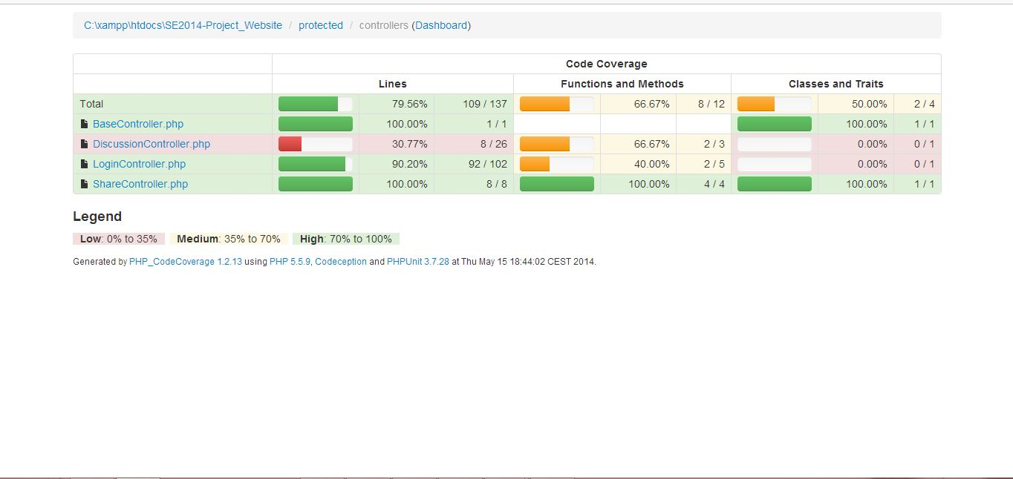
Testing

Slide 23
Demo
http://bluebee-uet.com/index.php

Slide 24
Q&A

Slide 25
Thank you for listening :)

